Slide 1
Chinese Text Summarization
Team 8: Chengyu Chen, Yuan Ding, Jiyang Ge, Yupei Zhou
Notes:
In the following slides we will introduce our problem along with what we have accomplished.

Slide 2


Introduction
Notes:
As countless social platforms develop and become more accessible, the types of contents shown on them also become more and more diverse.
For example, people can use them to check daily news, video and blogs, etc.

Slide 3
Solution: Text Summarization model
Problem
News have no title
Waste time for editor, waste money for company
Editor add subjectivity
Grab attention, exaggerate/distort true meaning
Enable users to target on the interested news
Save time and save money
Make title more objective
Notes:
However, there are some underlying problems associated with the news posted on social media.
First, some of the news didn’t have a title associated with it.
Even if it does, editor need to spend extra time to write those titles, and company will spend more money in paying those extra hours.
Third, editor usually add subjectivity when creating those contents
Moreover, in order to grab reader’s attention, some will even exaggerate/distort the true content’s meaning
Therefore, in order to solve all those problems, we created automatic text summarization model that is able to generate a summary given a text.
This model enable users to target on the interested news.
And also not only help to save editor’s time but help company to save money.
Lastly, it also make the title to become more objective.

Slide 4
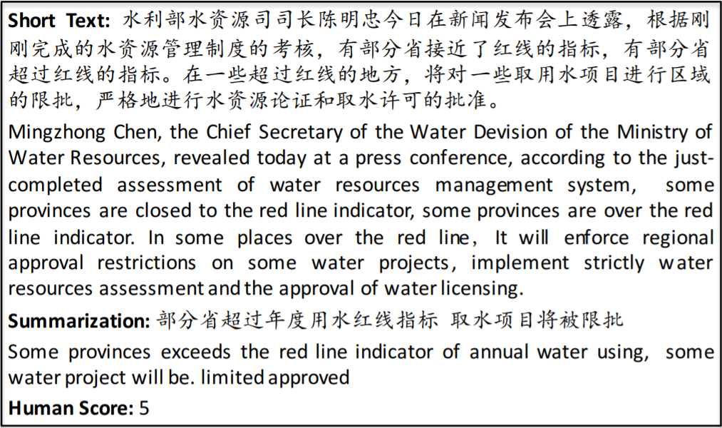
Data Layout
Data source: Large scale Chinese Short Text Summarization dataset*
Data Content:
10,666 human labeled (short text, summary) pairs
Text: ~80 characters; Summary: [10,30] characters
From Chinese microblogging website Sina Weibo
Domain of politic, economic, military, movies, etc.
*source: Qingcai Chen Baotian Hu and Fangze Zhu. 2015. Lcsts:
A large scale chinese short text summarization
dataset. in proceedings of the 2015 conference on
empirical methods in natural language processing.
lisbon, portugal, 1967–1972.
Notes:
The dataset we used is called
Those contents span various domain.

Slide 5
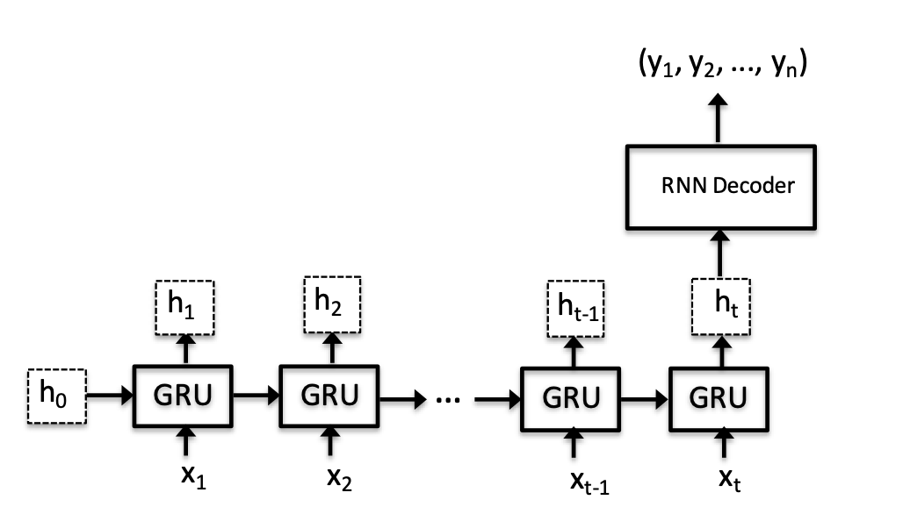
Approach
Baseline (RNN)
Sequence to sequence model
RNN as encoder and decoder, add attention, beam search
BERT as encoder and transformer decoder as decoder, multi-head attention
*source: Qingcai Chen Baotian Hu and Fangze Zhu. 2015. Lcsts:
A large scale chinese short text summarization
dataset. in proceedings of the 2015 conference on
empirical methods in natural language processing.
lisbon, portugal, 1967–1972.

Slide 6
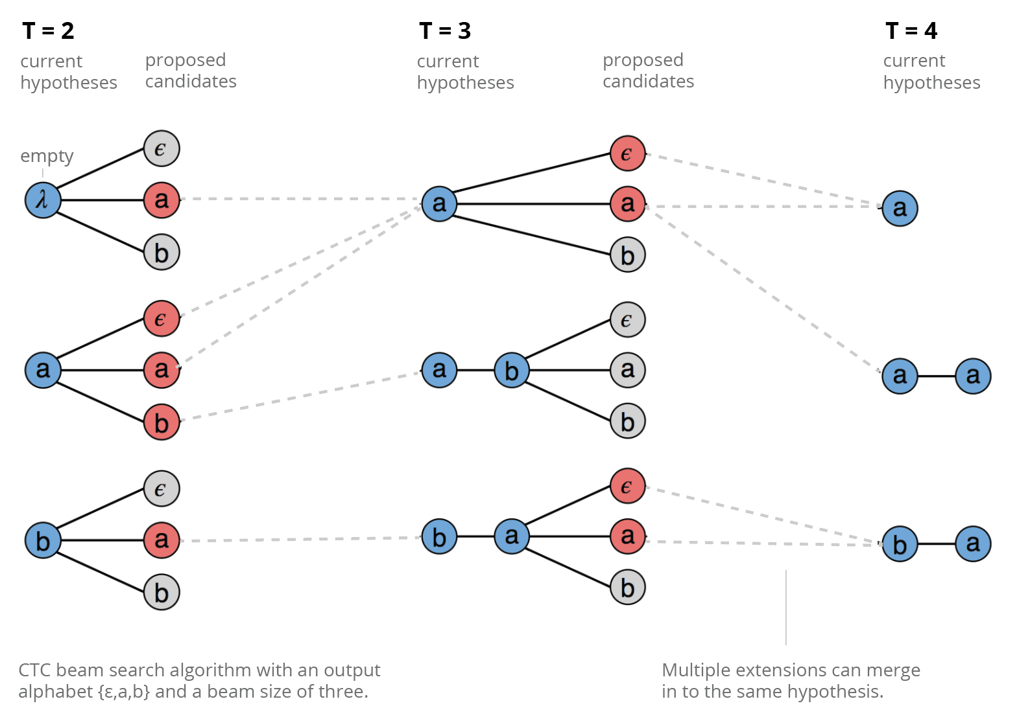
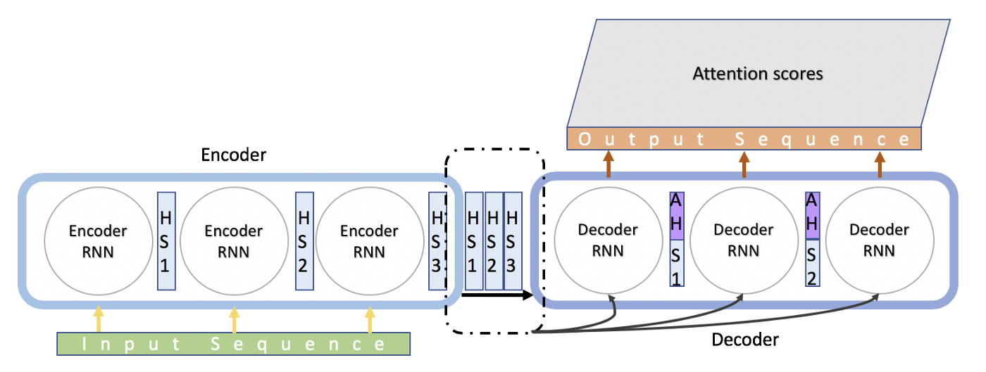
Approach 1
Data Processing:
Word based method
Segmented into Chinese words using package jieba
Model Training

Slide 7
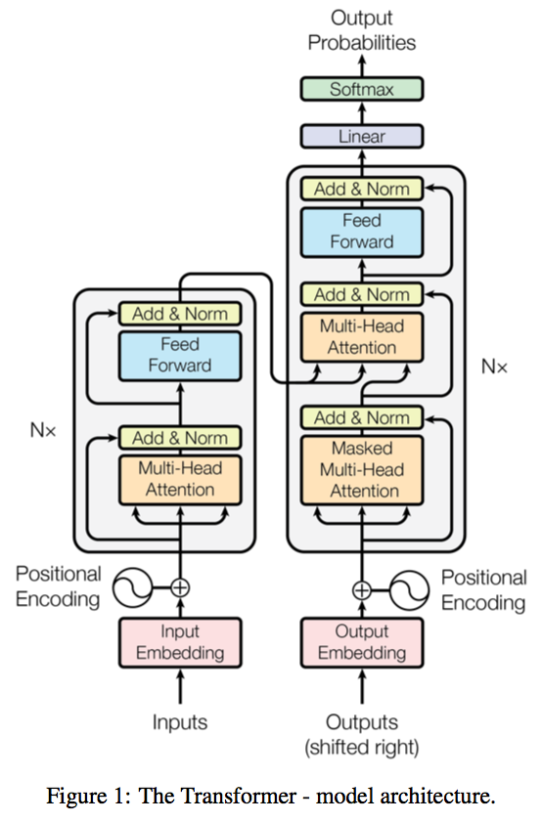
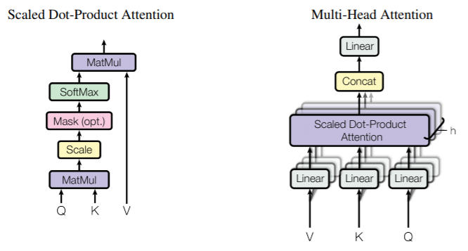
Approach 2
Pretrained BERT model as encoder: bert-base-chinese(https://huggingface.co/bert-base-chinese)
Transformer decoder

Slide 8
Results
Evaluation metrics:
ROUGE-n: refers to the overlap of n-gram between the prediction and reference summaries.
ROUGE-L: Longest Common Subsequence (LCS) based statistics, taking into account sentence level structure similarity and identifies longest co-occurring in sequence n-grams automatically.
Scores | Rouge-1 | Rouge-2 | Rouge-L
RNN without attention (Chinese) | 0.060 | 0.010 | 0.055
RNN with attention (Chinese) | 0.163 | 0.080 | 0.150
BERT encoder + transformer decoder (Chinese) | 0.270 | 0.108 | 0.253
BERT encoder + transformer decoder (English) | 0.313* | 0.134* | 0.295*
*sources: Aksenov, Dmitrii, et al. "Abstractive Text Summarization based on Language Model Conditioning and Locality Modeling." arXiv preprint arXiv:2003.13027 (2020).
Notes:
Now let’s look at the result:
For text summarization task, the commonly used metrics are rouge scores:
USUALLY WE have two types of xxx
We can see that our RNN model with self-attention mechanism outperforms the baseline RNN model from the paper, and the model using BERT encoder +
transformer decoder gives better performance than the RNN model
In addition, when the same model was applied to English language rather than Chinese, all three scores get higher, which indicates that doing text summarization task in CHINESE is more challenging

Slide 9
Results(Examples)
Summary: 10门酷毙了的云计算编程语言
Prediction: 10门酷毙了的云计算编程语言
Summary: Ten cool cloud computing programming languages
Prediction: Ten cool cloud computing programming languages
Summmary: 海南政府服务热线将统一为：12345
Prediction: 海南整合各类服务热线将统一为1234512345
Summary: Hainan government service hotline will be unified as: 12345
Prediction: Hainan integrates various service hotlines and will unify them to 1234512345
Summary: 望城区一届人大三次会议将于12月29-31日召开
Prediction: The Third Session of the First People's Congress of Wangcheng District will be held on December 29-31
Summary: 望城区召一届人大代表召开会召开会议议议
Prediction:Wangcheng District called the first People's congress to hold a meeting, hold a meeting, meeting
Notes:
Here we listed some examples of the result with our best performed model:
we can see that in each summary and prediction pair, there are a few identical patterns, which can give the same information to the human readers and help us understand the meaning of the original text, but in the prediction, there still exists repeating characters and noises that can limit the quality of the summary, so we still have a large space to improve the model’s performance
Ok, THIS IS THE END OF OUR PRESENTATION. Please feel free to leave any comments and questions under our post and we would welcome all kinds of discussions.
Thank you so much for watching this video and we hope everyone stay safe!

Slide 10
We are open to questions, please feel free to discuss with us any time !

Slide 11
References
https://www.aclweb.org/anthology/D19-1301.pdf
https://arxiv.org/pdf/1506.05865.pdf
https://arxiv.org/pdf/1506.01057.pdf
https://www.aclweb.org/anthology/W04-1013
https://www.aclweb.org/anthology/P18-2115
https://towardsdatascience.com/day-1-2-attention-seq2seq-models-65df3f49e263
https://arxiv.org/pdf/1706.03762.pdf
https://arxiv.org/pdf/1703.03130.pdf

